Slide 1

Analysis of COVID Vaccination Rates

Slide 2
Overview
Reason Topic was selected -- address a public health issue
Datasources
Questions we hope to answer
Results
Notes:
Fun but overall fluff helpful as reminder for what jumping into. Maybe an overview of how the presentation will flow:

Slide 3
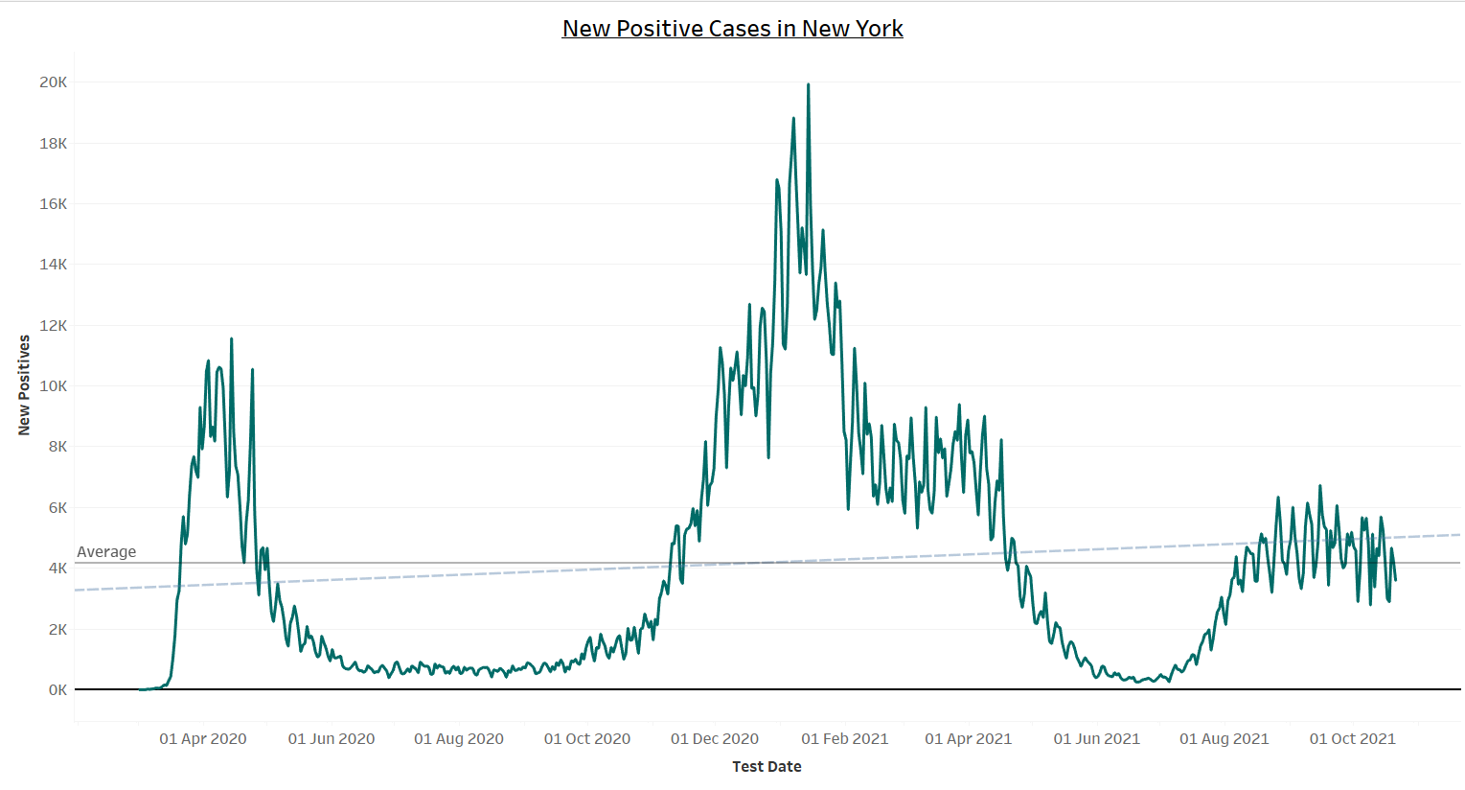
Notes:
Attention to rise in cases trend as we discuss boosters in our world and why we wanted to examine who gets vaccinated

Slide 4

What factors influence an individual to get the COVID-19 vaccine in New York State?
Notes:
The question(s) we hope to answer with the data. A story to be told: [reformat to business/grant pitch style for analysts]
Analyst at Geo-Data-Lab have observed that pandemics did not begin with Covid 19 they in fact have always caused massive loss of lives globally
• They know that never before has there been a global deployment of vaccinations that may actually change the course of the future of pandemics in terms of loss of life
• However alarmingly there is not a 100% buy in by the population to vaccinate!
• The analysts have decided to focus their study on New York State one of the original epicenters of the Covid 19 virus
• They believe that a study on vaccination rates may shed light to the question
• What influences vaccination rates?
• They believe the answer to this question is important as it would not only help with the deployment of the current Covid 19 vaccination and booster shots
• They are hopeful that the information gleaned can be used as a catalyst in public acceptance of vaccinations and would make future deployments more successful!
• The CEO of GIT-Science USA – Dave Saranchak and his board of directors have gotten wind of the amazing research being conducted at Geo-Data-Lab
• They have showed interest in funding the research if the analyst can prove that their data driven insights can be used to understand the factors that drive vaccinations as well as use the observed results for future deployment of vaccinations
• Kristin Allocco, John Freeman, Helena Rabasco, Tara Keckeisen, Mikyle(Kyle) Yuvienco and Portia Wallace
• Will use their combined knowledge of ML, SQL, Tableau, GeoJson Maps to find and display insights from their research
• It will be great to get that funding and contribute to the future health of society at large!
]

Slide 5
Technology
Technology
Database
Machine LEarning
Visualization
Data Cleaning and Analysis
SciKitLearn & Tensorflow
Dashboard
Pandas, Python, & GoogleCollab.
ML libraries we'll be using to create a classifier
Heroku, HTML & Tableau
Database
Storage
PostgreSQL is the database used for data.
Notes:
Other potential visual of analysis process: Database → Machine Learning → Analysis → Visualization
*Discuss technology used at and what capacity

Slide 6
How we chain our analysis
Tech/Database
Feature Selection
Machine Learning
Visuals
Notes:
***Order: tech, database, feature selection [results of multiple regression for which factors most predictive], ML, Visuals displaying our data.
Discuss our exploration of the data

Slide 7




Gathering our Data
Notes:
Data Sources: As with all good research it depends on the validity & accuracy of the data used. This was a key concern for the team. We did many Google searches and found tons of data from a variation of different sources but our questions for each one was the same: is this a proper data source with data we can trust? And is the data in a format we can manipulate to fit our end needs? After the vetting process we settled on using data from government sources. The data sources chosen had to have a direct link to one of the following: the US Center for Disease Control, New York State entity(ies) and New York City entity(ies). Complete list of resources used can be found in this ReadMe.
Key Factors: Once we had our data sources drilled down, we began to see what they had to offer. The team brainstormed on a myriad of factors that we believed had a correlation ranging from income, population density, demographic, fatality rates, hospitalizations, education, average form of transportation (i.e. car v public transit) etc. We ultimately decided that for the scope of this project, the key factors we wanted to focus in and analyze were: household income, Race/Ethnicity, housing type & if there was a correlation between them & NYS vaccination rates by county,.
How do we clean our data. We used Pandas, Python, and SQL to form our databases

Slide 8

API Data Source
Code used for API data pulls
Resource: https://covidactnow.org/data-api
Our original database pulled from multiple sources with different schemas. Covidactnow.org pulls and aggregates these sources for us together cleanly.
Notes:
COVIDActNow aggregated a lot of our data sources to an updated api

Slide 9
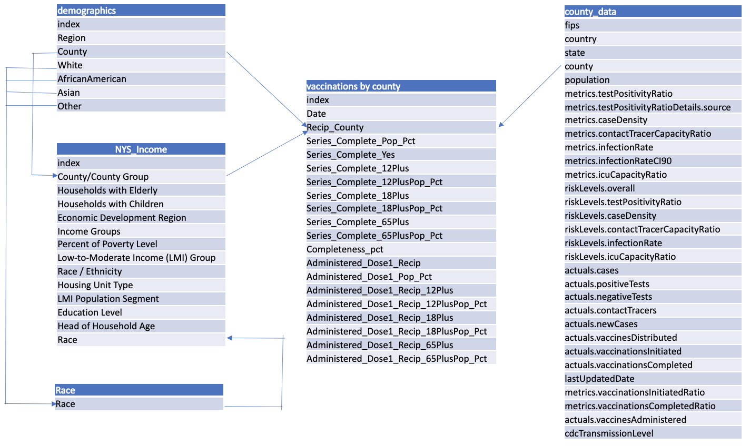
Entity Relationship Diagram
Notes:
In our database we had five tables; four of the tables were imported via SQL Alchemy with a Pandas DF join, one of these four (NYS Income table) was then merged with another table (race) using SQL within the database, and the final one was an original table created within SQL, which was parsed from the demographics table in order to be merged. This gave the team five static data tables to work with in the later steps.
Our primary key used to connect the tables was the county column. This was a one to many or a one to one relationship varying on the datatables used.
How did we connect the database to our ML model? How do they interact?

Slide 10

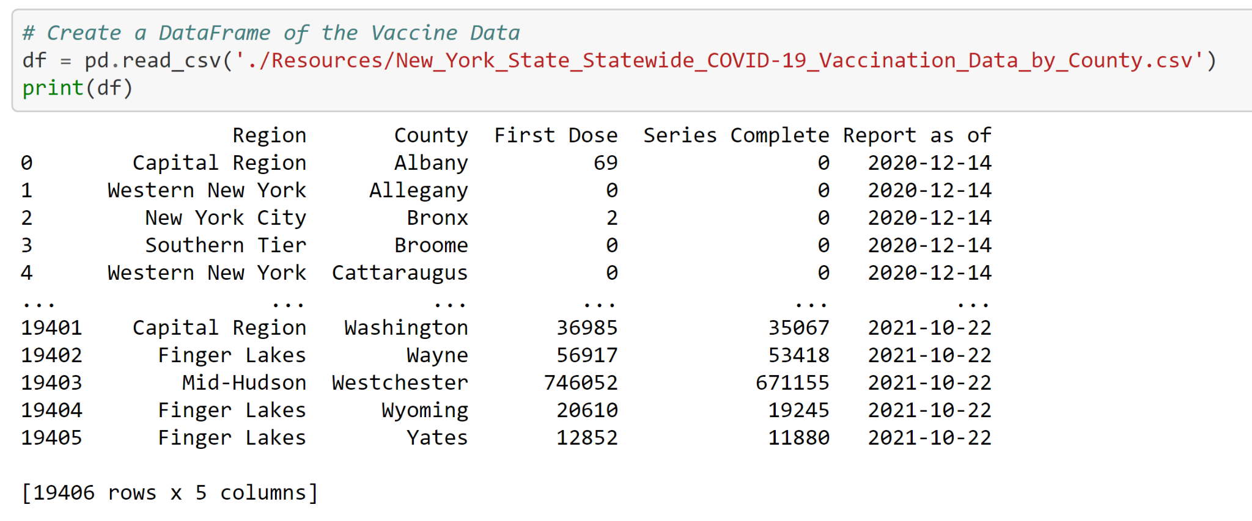
Database
Notes:
Section where speaker will discuss how we used Pandas and PostgreSQL to clean and create our database from our original datasets

Slide 11
19,406
rows
Notes:
Many vaccines. Such wow.

Slide 12
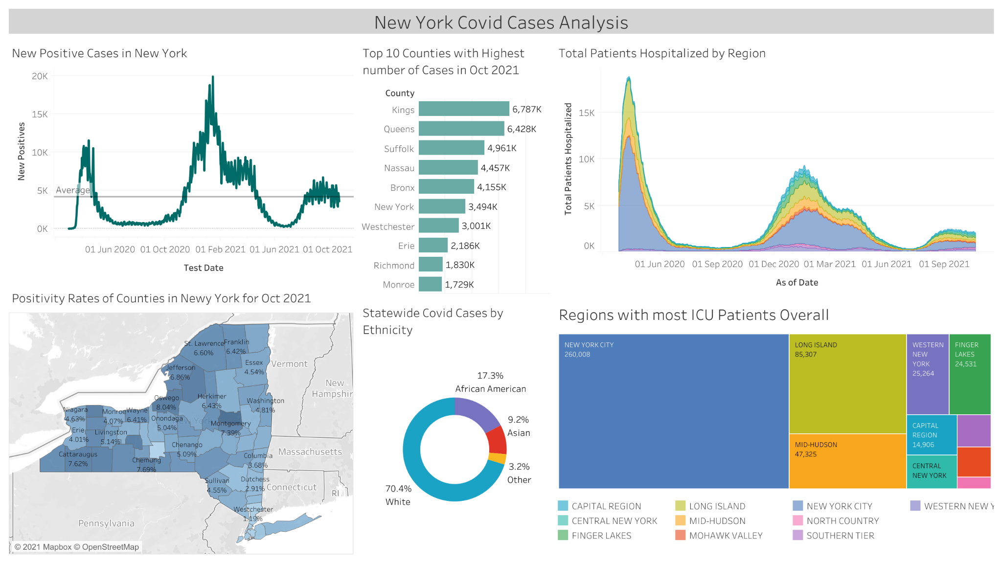
Now we have A LOT of data. How do we narrow down our focus?
Notes:
Visual and how we narrowed down our demo target. Begin exploration of analysis phase of project

Slide 13
Feature Selection
What demographics predict COVID-19 vaccination rates among New York State residents?
Our team conducted a Multiple Regression to determine which demographic feature(s) could predict vaccination rates.
Features
Age (Households with Elderly, Households with Children, Head of Household Age)
Race / Ethnicity
Education Level
Housing Type (e.g., single family home, multi-family apartment unit)
Income (Household Income, Percent of Poverty Level, Low-to-Moderate Income groups)
Population
None of the demographic variables predicted vaccination rates with R² = 0.4769, p = 0.1286 and all demographic variables p > 0.1. Given that there was not a significant relationship between vaccination rates and any demographic factors, we chose to not exclude any demographic factors from our model.
Notes:
Limitation - multiple regression model was likely underpowered so it was not predictive. Future research should use larger region to determine predictors.

Slide 14
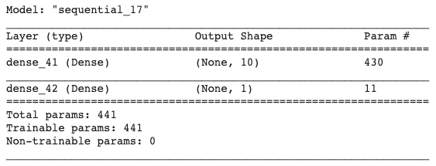
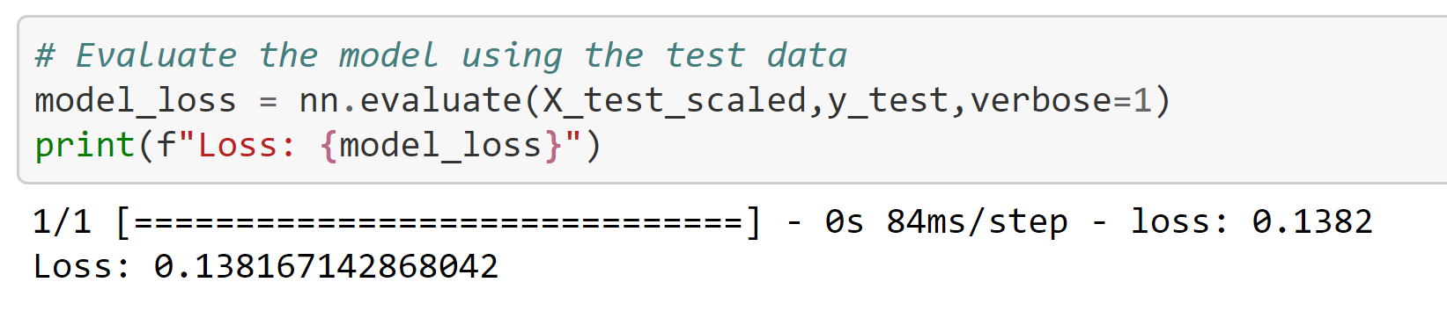
Machine Learning
Using a Neural Network to Predict Vaccination Rates
Design
Hidden layer: tanh
Output layer: linear activation function
Training: 100 epochs
Results
Training loss (mean squared error): 0.1391
Testing loss (mean squared error): 0.1382
Notes:
Chose this model because it can predict the vaccination rate based on a large number of demographic factors
Call out that linear model does not have accuracy score so loss is used to determine efficacy
Simplified original model to prevent overfitting (was causing a large difference between the test and train loss).
The original model had two hidden layers with 100 nodes per layer and multiple activation functions (tanh and relu).

Slide 15

Machine Learning
Limitations
Unable to pinpoint the exact feature or set of features that are most predictive of vaccination rates
Only trained with New York State data in November 2021. Predictors likely change for other regions and over time.
Applications
This model can be used to predict COVID-19 vaccination rollouts based on the demographic composition of a county.
Future New York State applications include predicting booster vaccination rates once the booster is made available to the general public.
We recommend continuing to train this model with data from other regions (e.g., United States overall) and over time.
Notes:
Limitations: talk about how we used multiple regression to try to address limitation #1

Slide 16
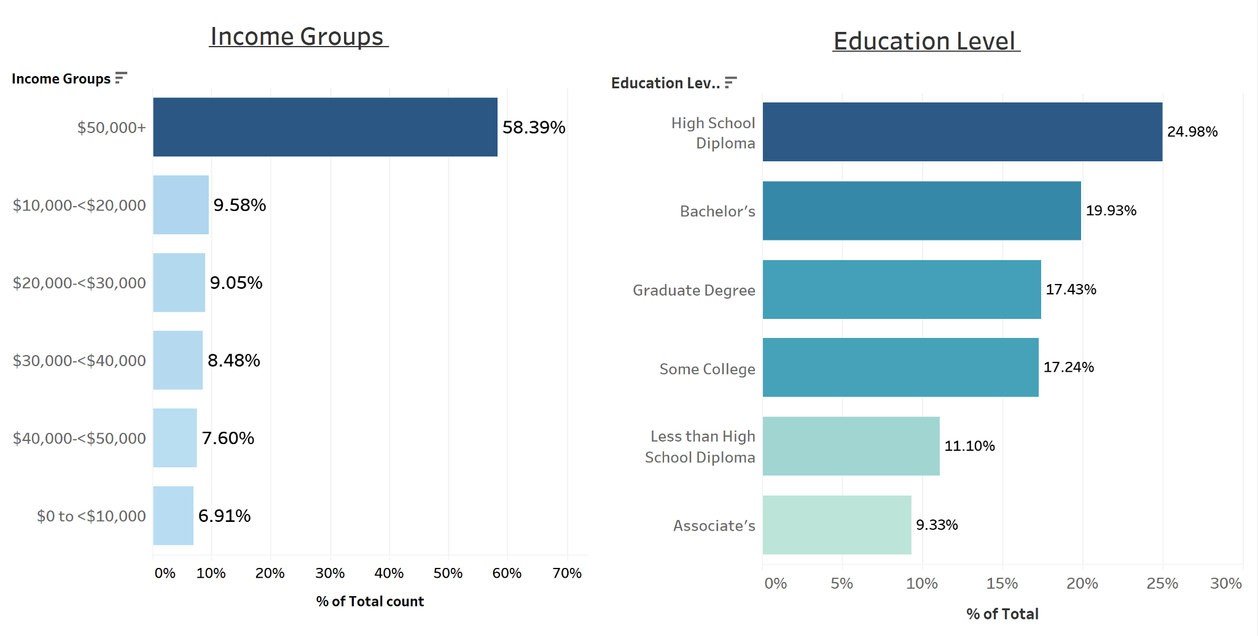

Notes:
NY Covid Cases Analysis: https://public.tableau.com/app/profile/tara.keckeisen/viz/CovidAnalysisDashboard_16361561521150/NewYorkCovidCasesAnalysis

Slide 17
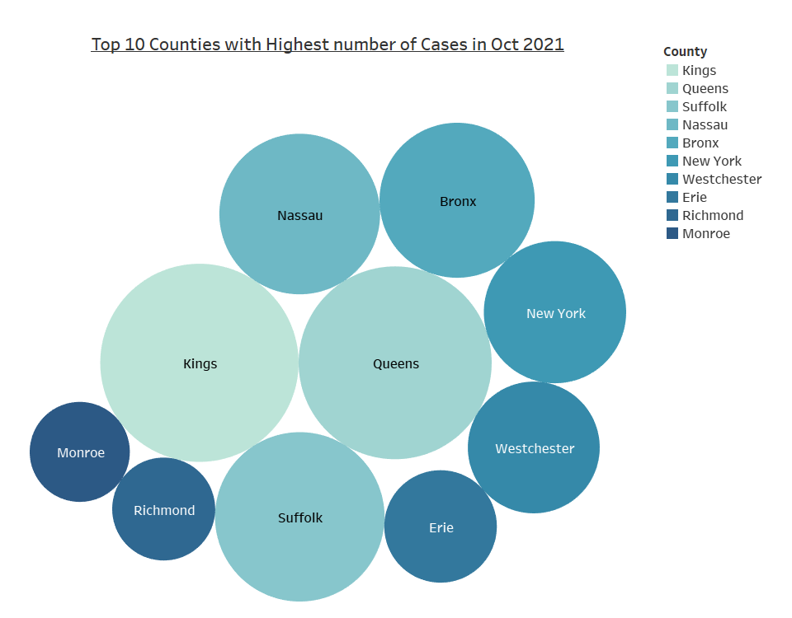
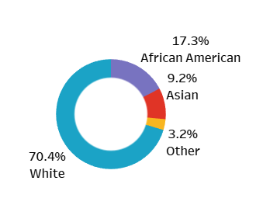
Notes:
Interactive graph link (Trend Chart by County & Doses): https://public.tableau.com/app/profile/tara.keckeisen/viz/TrendChartbyCountyandDoses/TrendChart?publish=yes
Interactive graph link (Doses Administered):https://public.tableau.com/app/profile/tara.keckeisen/viz/DosesAdministered_16361597995400/DosesAdministeredvs_FullyVaccinatedPopulation?publish=yes

Slide 18
89,526,124
185,244 users
100%
That’s a lot
And a lot of users
Total success! 0% margin of error!
Notes:
Place holder of other big numbers of significant data to highlight after further analysis.

Slide 19
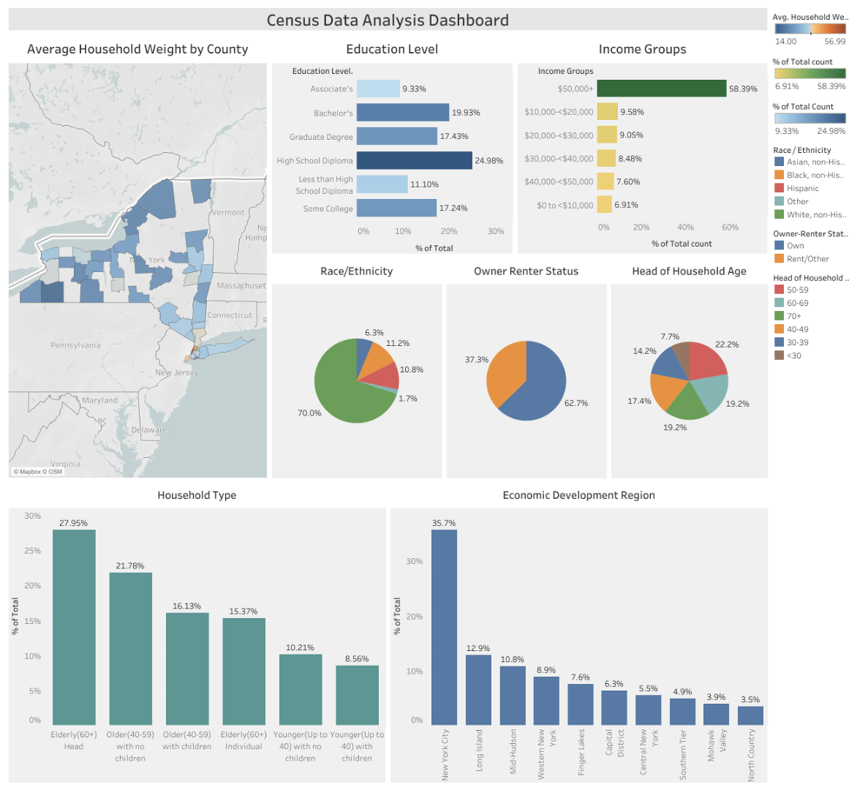
Notes:
First visuals should be of the database and the datasets we are using
NY Census Data Dashboard: https://public.tableau.com/app/profile/tara.keckeisen/viz/NYCensusDataAnalysisDashboard/Dashboard1

Slide 20
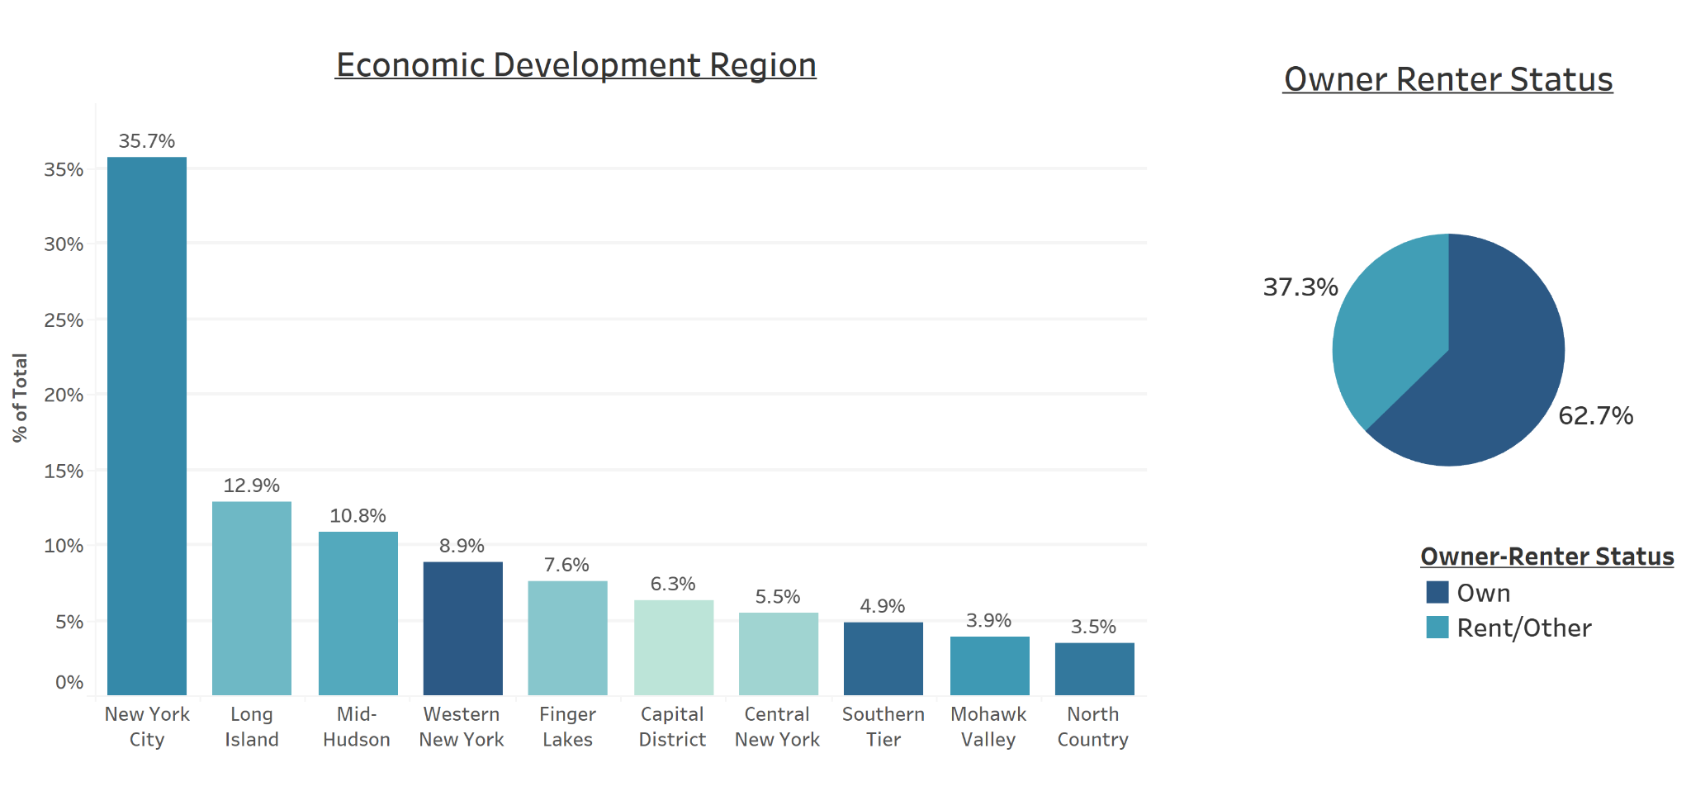
Notes:
Visual on map of vaccinations across NYS: https://public.tableau.com/app/profile/tara.keckeisen/viz/VaccinationInteractiveMapofNY/MetricMap?publish=yes

Slide 21
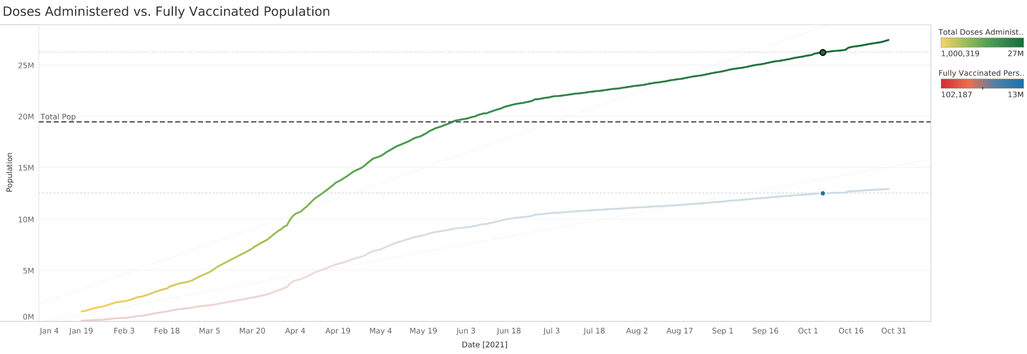
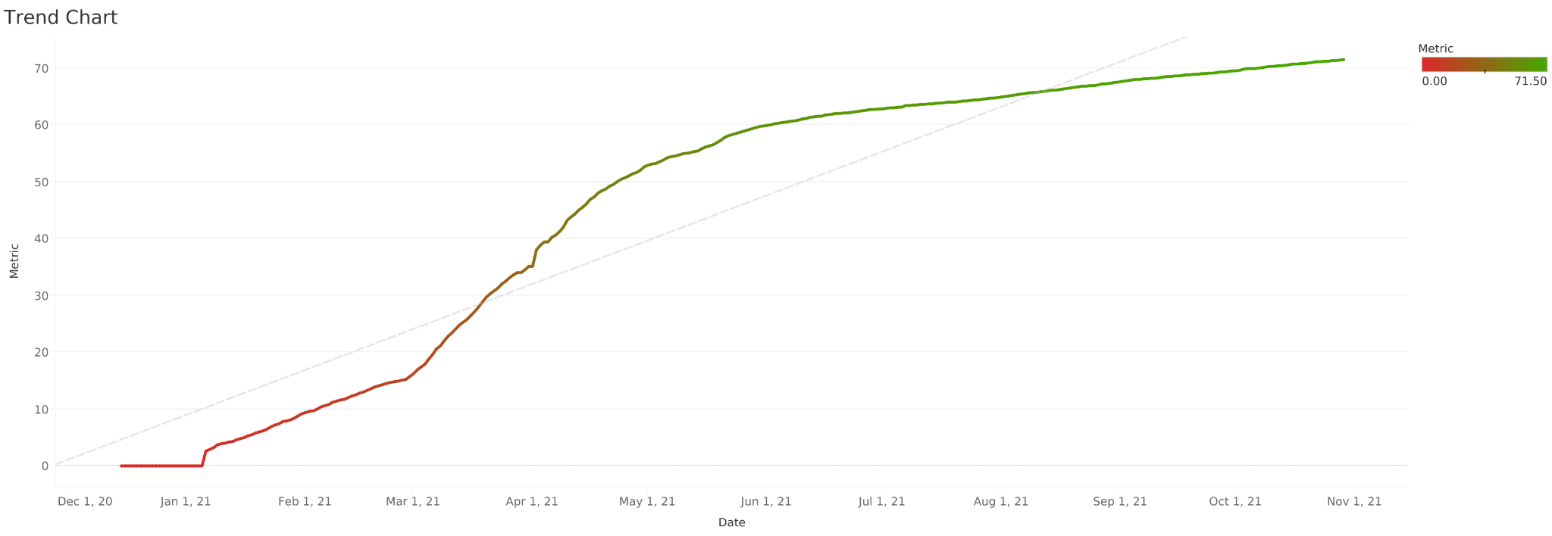
Notes:
Interactive graph link (Trend Chart by County & Doses): https://public.tableau.com/app/profile/tara.keckeisen/viz/TrendChartbyCountyandDoses/TrendChart?publish=yes
Interactive graph link (Doses Administered):https://public.tableau.com/app/profile/tara.keckeisen/viz/DosesAdministered_16361597995400/DosesAdministeredvs_FullyVaccinatedPopulation?publish=yes

Slide 22
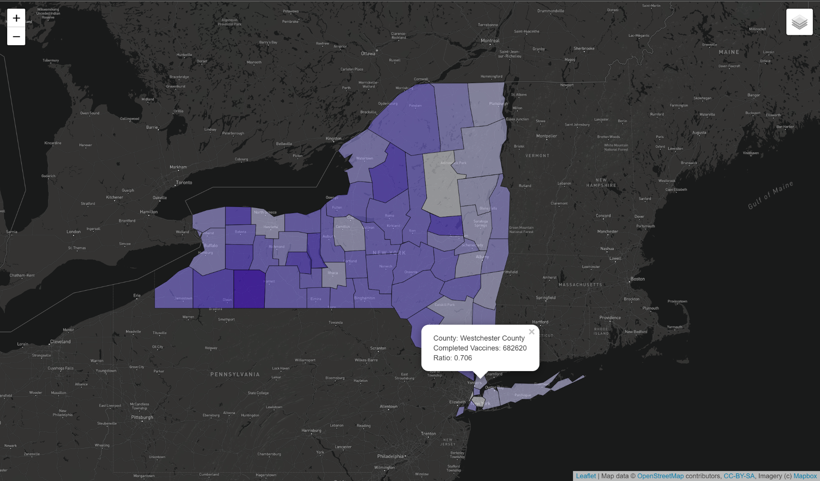
Maps - Vaccinations
Notes:
GeoJSON map screenshot. Will lead into the finished Dashboard tour section of presentation.

Slide 23
Results
Significance
Our Machine Learning model is predictive and accurate….
Demographics
There is no one specific demographic that solely predicts whether or not an individual will get vaccinated
Notes:
Results of our findings. Next few slides discussing the results, and how we can improve on our analysis with more time.

Slide 24
SWOT Analysis
STRENGTHS
Model is predictive and accurate.
WEAKNESSES
Unable to point to specific predictor
S
W
Broaden scope and test predictive ability. Multiple Regression model
OPPORTUNITIES
A Snap-shot of data that can change over time.
THREATS
O
T
Notes:
SWOT is great for post-mortem analysis of our data and how we can improve. STAY SAFE FRIENDS. DISCUSS THE FACTORS WE ANALYZE AND IT IS A UNIVERSAL ISSUE. ACCESS TO CARE AND INCOME DATA. WE DID NOT ACCOUNT COUNTY MANDATES AND HOW THEY FACTOR ACESSIBILITY.

Slide 25
Credits
Special thanks to all the people who worked on this analysis and the sources we used:
https://covidtracking.com/
https://health.data.ny.gov/browse?tags=covid-19
https://www1.nyc.gov/site/planning/planning-level/nyc-population/2020-census.page##2020-census-results

Slide 26
Team Presentation
Talk Data To Me
Kyle Yuvienco
Team Leader
Kristin Allocco Team Member
Portia Wallace
Team Member
John Freeman
Team Member
Helena Rabasco
Team Member
Tara Keckeisen Team Member
Notes:
Make this us.

Slide 27
THANKS!

